Slide 1
Neighborhoods in Oaxaca

Slide 2
Introduction
I am trying to recommend to an investor to run a business in Oaxaca, by opening a venue. Therefore, I must see what the most common venues around each neighborhood are.
I found a Data Base with all the postal codes in Oaxaca, included the neighborhood name (https://codigo-postal.co/en-us/mexico/oaxaca/oaxaca-de-juarez/)

Slide 3
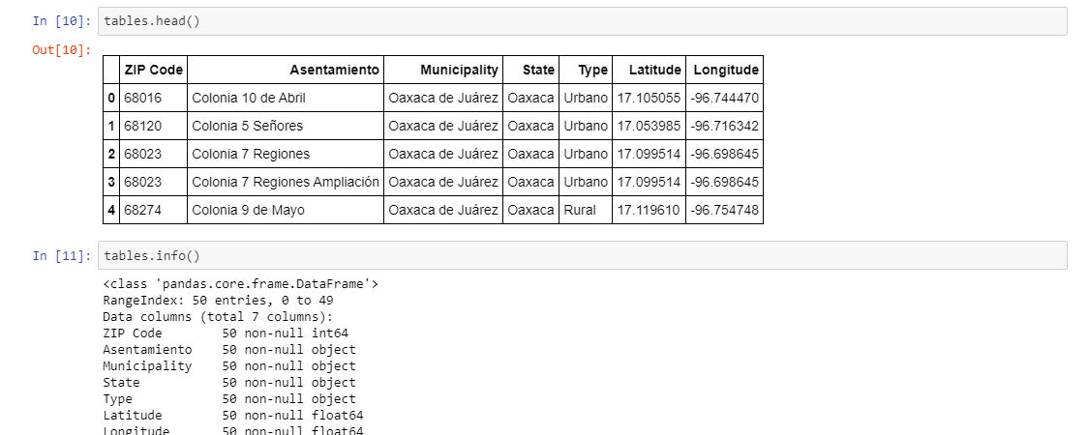
Data

Slide 4
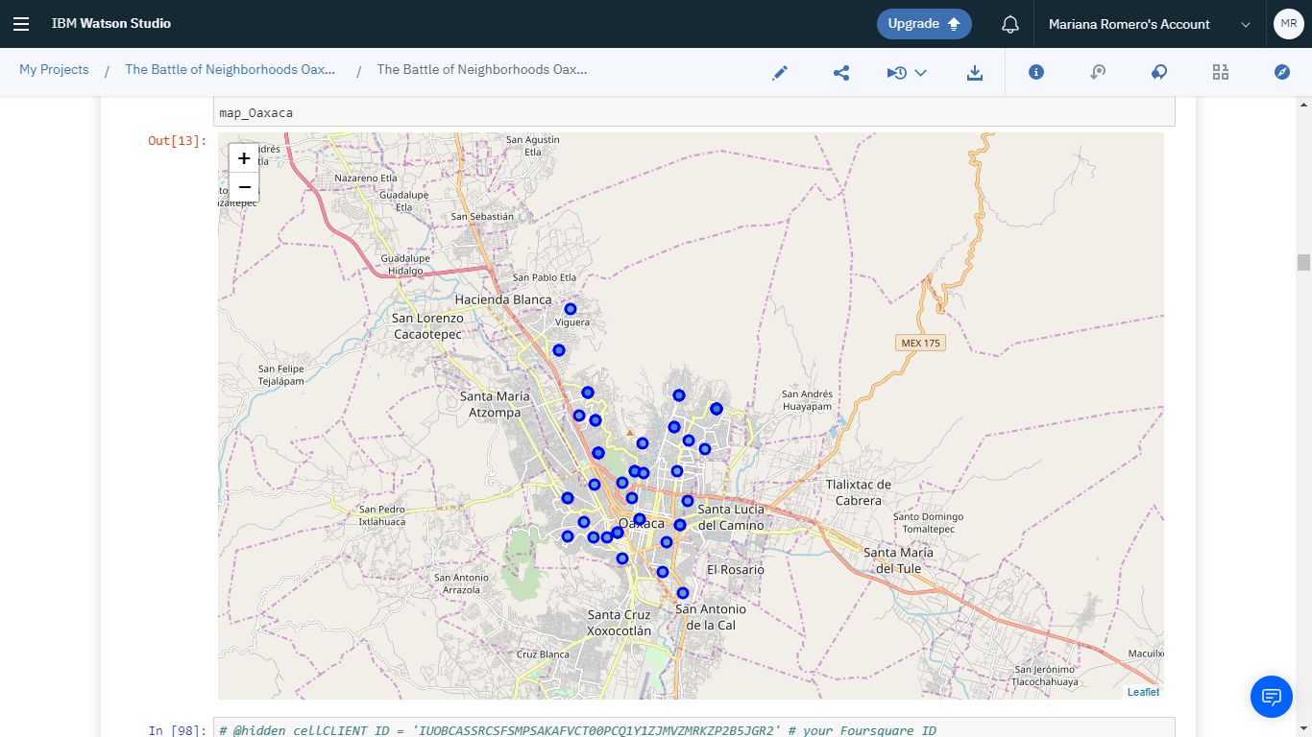
Data visualization

Slide 5
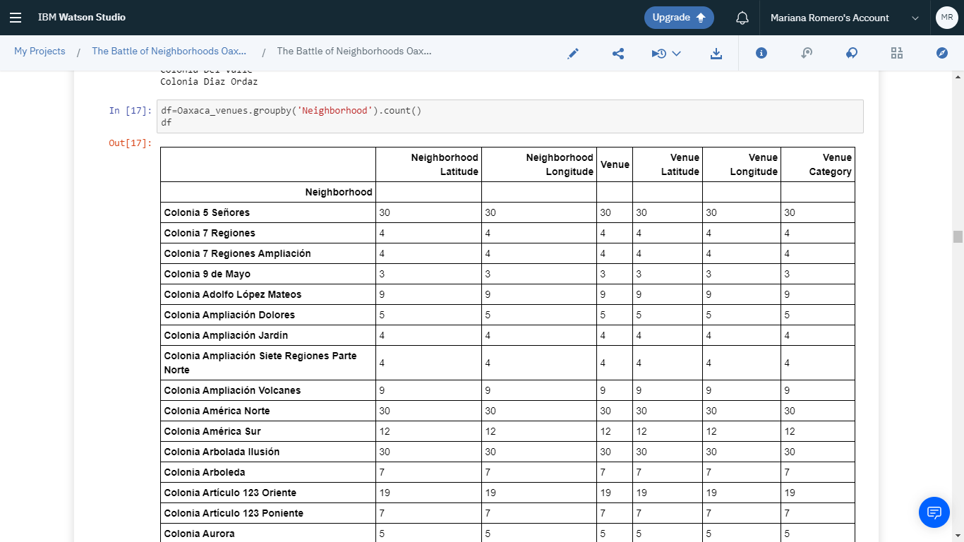
Venues in each neighborhood

Slide 6
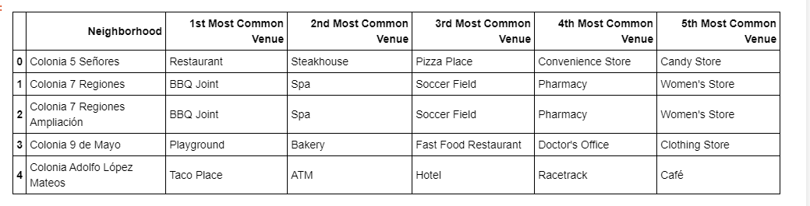
First 5 Most common venue

Slide 7
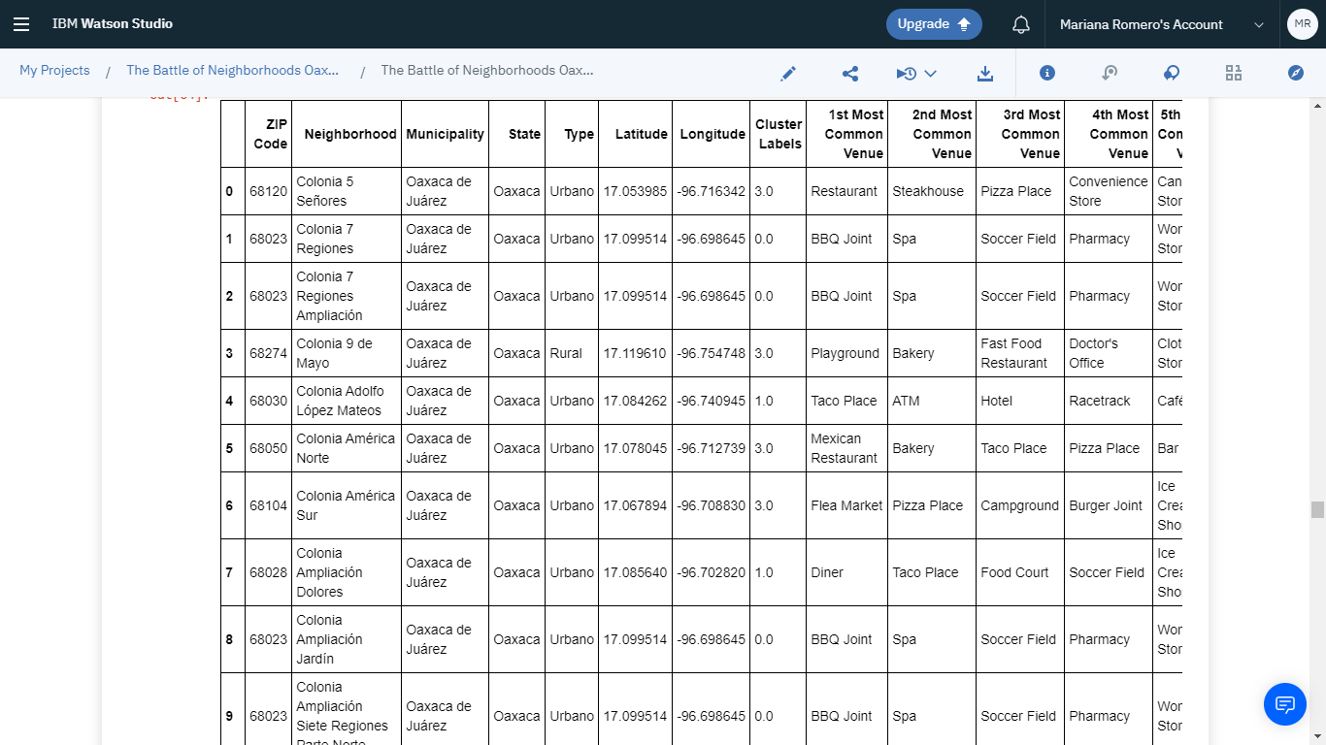
Neighborhoods with cluster label

Slide 8
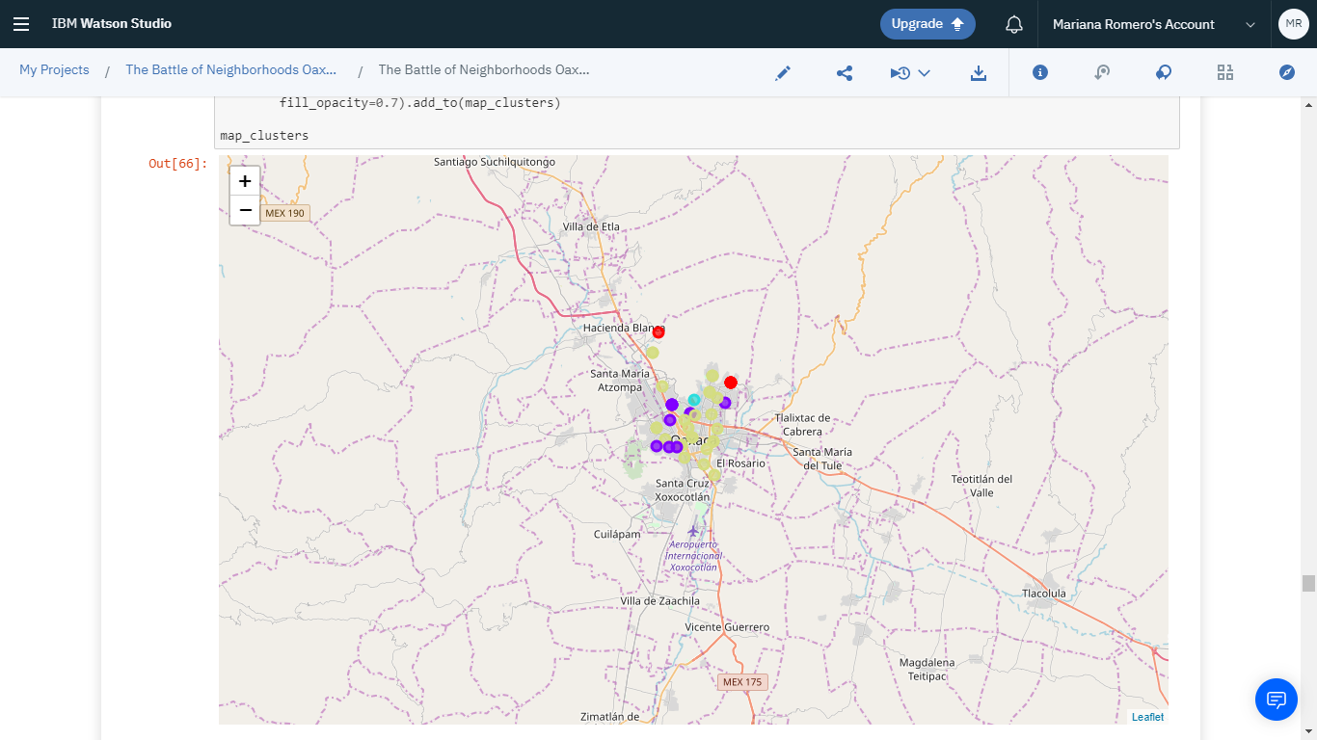
Visualization of our cluster results

